Slide 1

MBTA Train Management System.
DAMG 6210 : Final Project
Group 18: Lakshmi, Kartik, Rajas, Mihir, Harshveen

Slide 2
Overview :
The Massachusetts Bay Transportation Authority (MBTA) rail network is designed to address a various business challenges associated with the seamless operation of rail services. The implementation of advanced technology streamlines the tasks of data collection, processing, and reporting, thereby simplifying these processes. This technological enhancement not only augments operational efficiency but also contributes significantly to elevating passenger satisfaction levels.

Slide 3
Objective :
To create a database management system that will track and record data for the proposed train system (MBTA), which can be later used to elevate the overall commuting experience by managing various scheduling and management activities, and also, inform the people with utmost accuracy.

Slide 4
Business Problem :
Efficient Scheduling: Managing train schedules and ensuring timely arrivals and departures.
Rider Information : Providing real-time information to passengers about train arrivals, delays, and other relevant updates.
Maintenance Tracking : Monitoring and scheduling maintenance activities for the train fleet
Resource Management : Efficient relocation of resources such as train cars, crew members, and maintenance personnel
Financial MAnagement : Keeping track of budgeting and cost allocation for various train operations

Slide 5
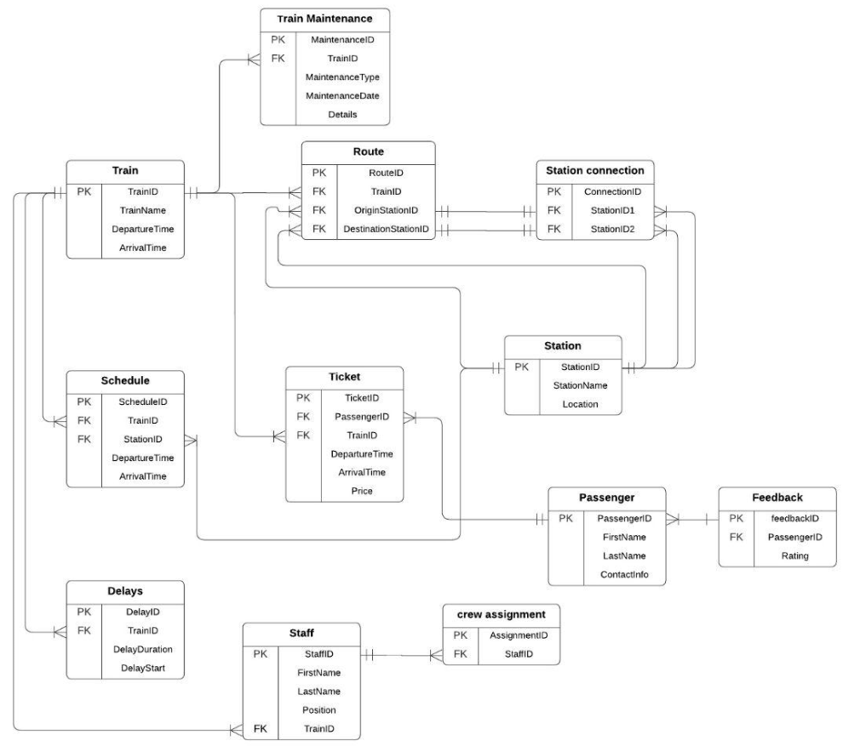
Entity Relational
Database :

Slide 6
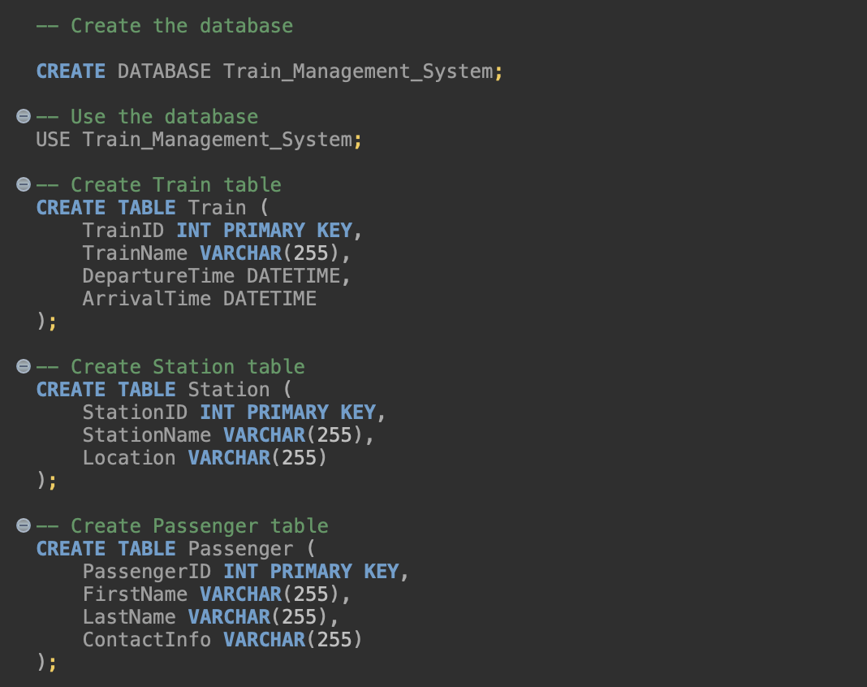
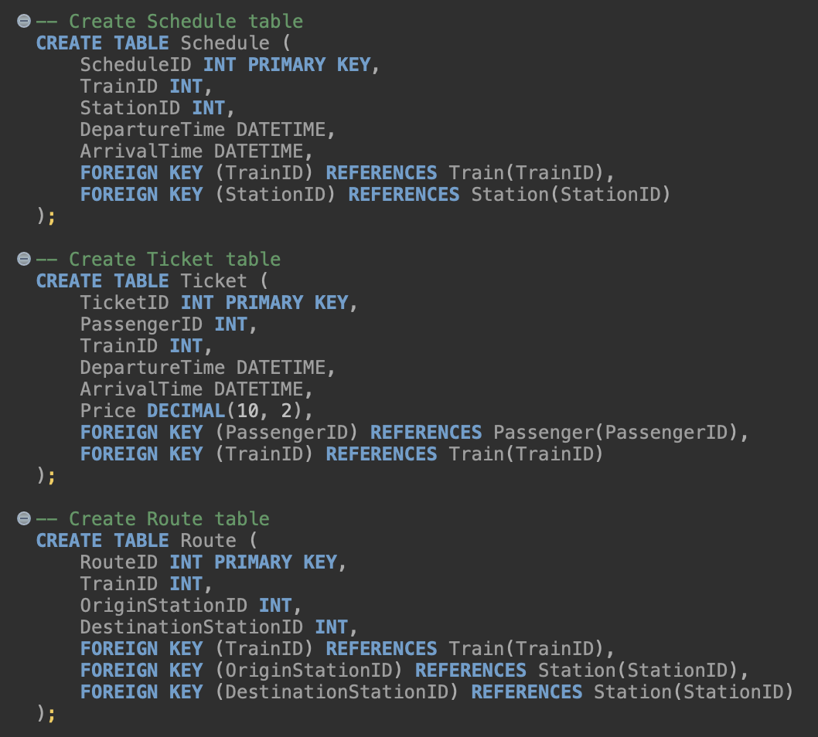
SQL Tables

Slide 7
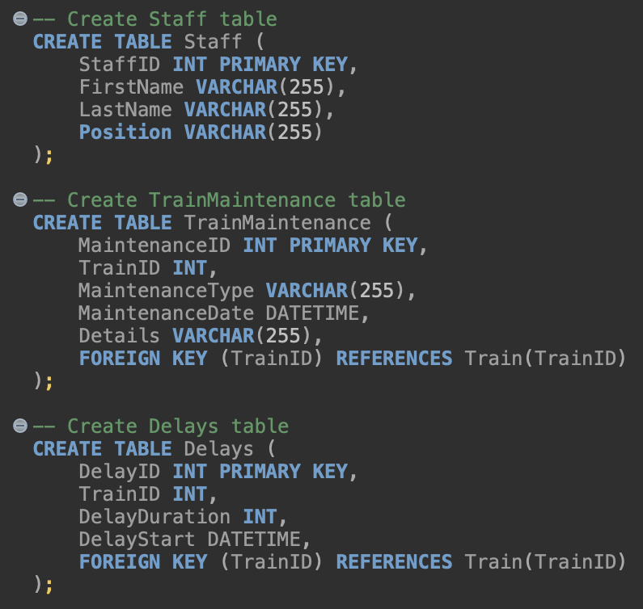
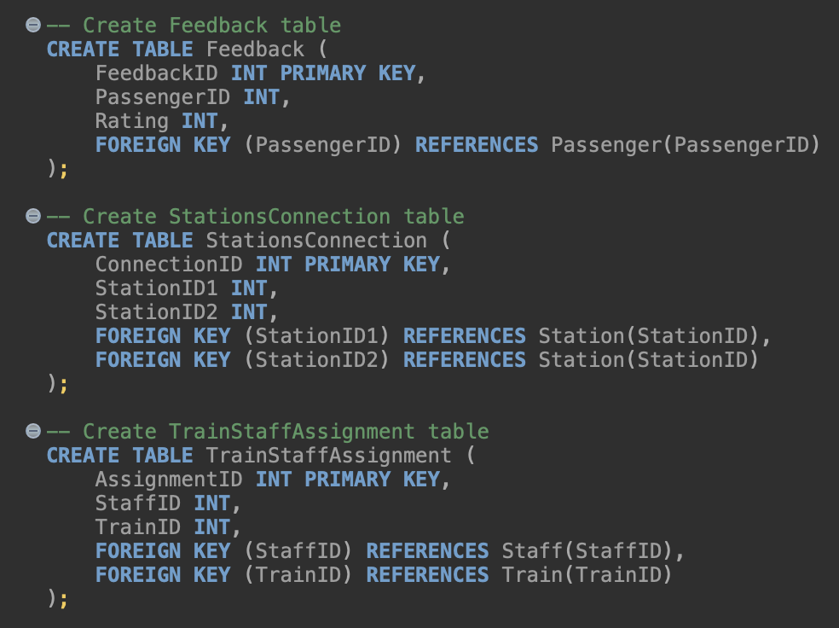
SQL Tables

Slide 8
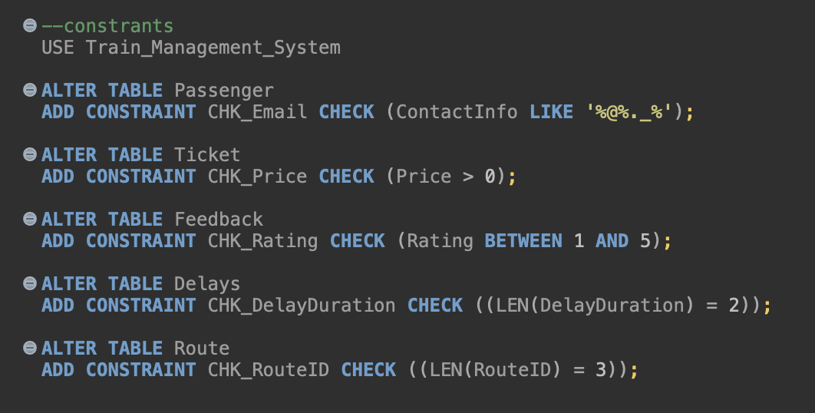
Table level CHECK constraints

Slide 9
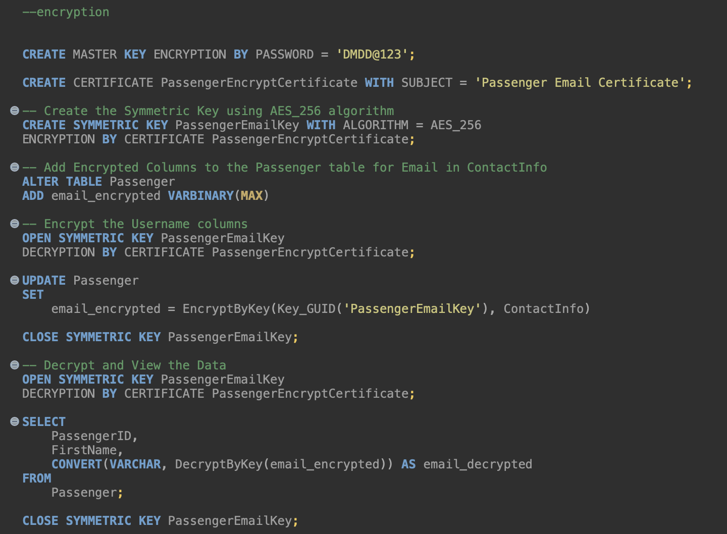
SQL Encrypted Column

Slide 10
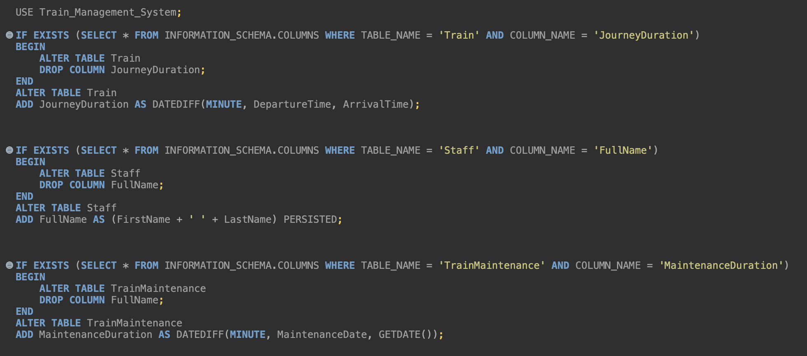
Computed Column (functions)
Replace this box with code screenshot

Slide 11
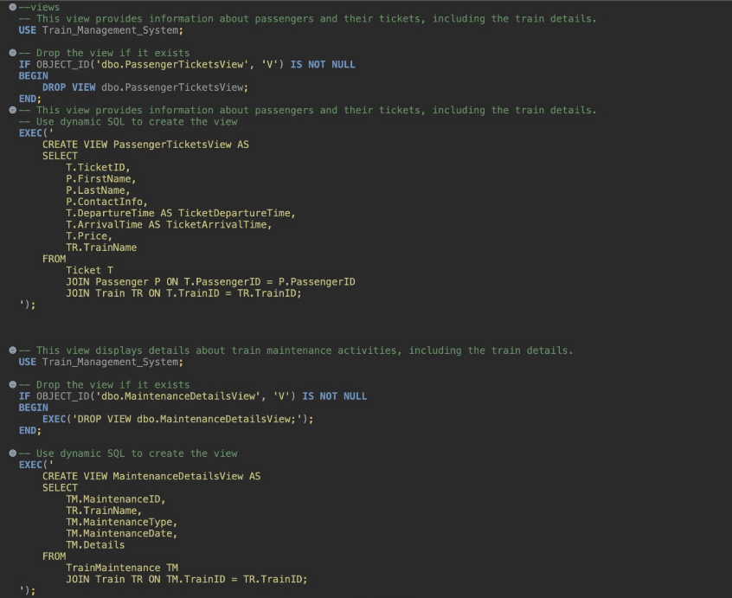
Views

Slide 12
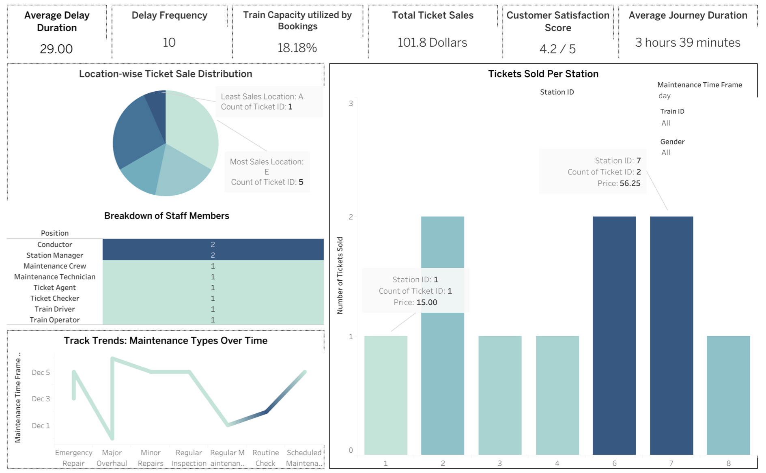
Data Visualization

Slide 13
Conclusion :
Throughout the entirety of the project, we acquired profound insights into the intricacies of crafting a relational database tailored for contemporary business needs, commencing with a methodical approach. This encompassed meticulous steps such as discerning and addressing business challenges, establishing clear project objectives, collating essential business requirements, formulating comprehensive design documents, constructing an Entity-Relationship Diagram (ERD), aggregating pertinent data, and culminating in the adept implementation of a robust SQL database.

Slide 14
Thank You.
DAMG 6210 : Final Project : MBTA Train Management System.
Group 18: Lakshmi, Kartik, Rajas, Mihir, Harshveen

